Slide 1
Train an LSTM model to predict the next number in the sequence.
Deep Learning – Practical 9

Slide 2
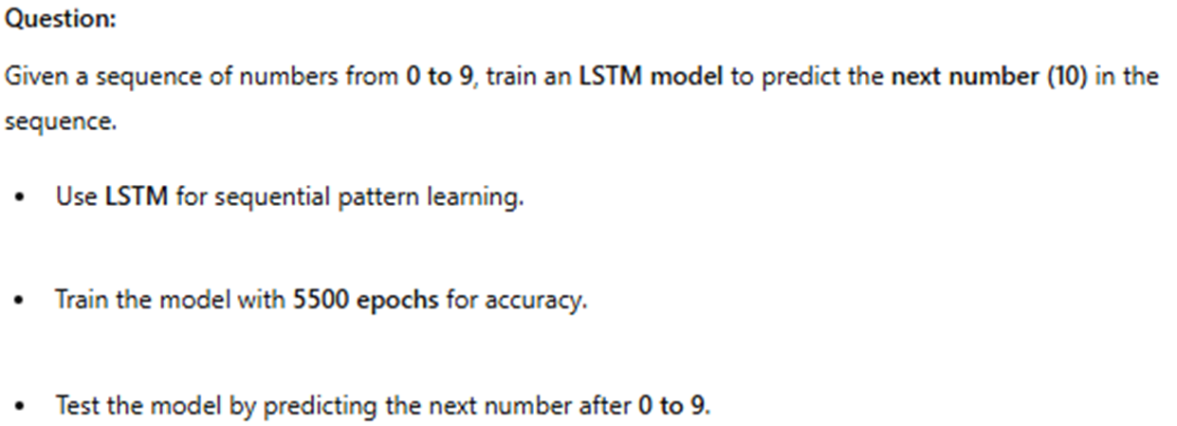

Slide 3





Slide 4





Slide 5
